Slide 1

Workplace assistant augmented reality
Gabriel Camilleri

Slide 2
Problem Definition

Slide 3

Problem Definition
To build a real-time assisting application which can help interns and visitors easily adjust within a workplace
An application which would address job-fit and job-stress for new employees
To provide an assistant augmented reality application
Choosing the right AR and recommendation techniques for the right context in which they are to be applied in.

Slide 4
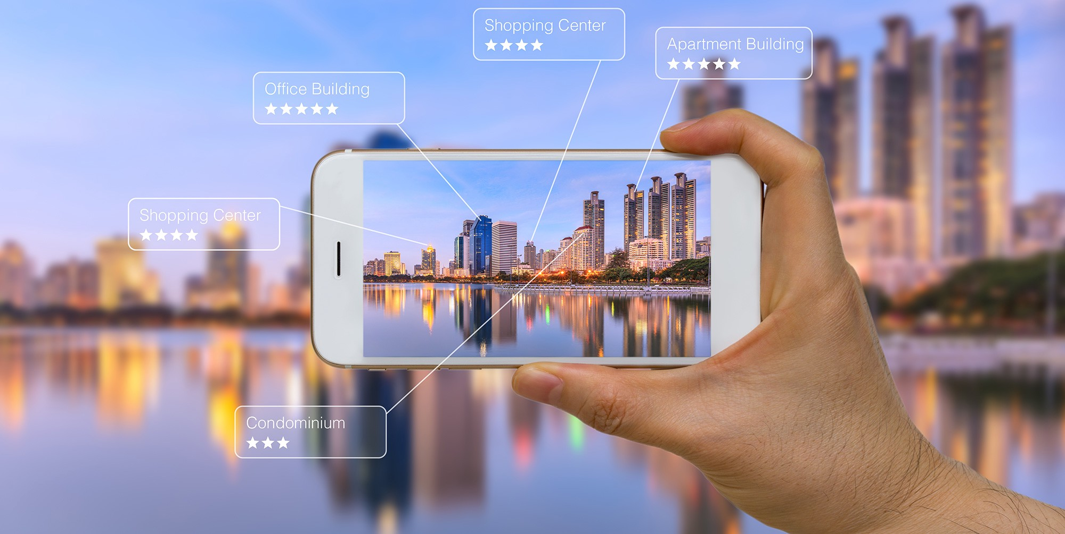
Research Questions
Which is the right Augmented Reality Library for the current context?
What are the right computer vision techniques to apply?
What models and techniques are suitable to implement user recommendation depending on the user’s task at hand?

Slide 5
Background and literature review

Slide 6
Background Research and Literature Review
Workplace AR training normally is provided in two forms:
On the job training
Off the Job training
AR can provide training by overlaying 2D and 3D information in real-time, whilst also providing the users the ability to author the environment around and interact with it.
Vuforia is compatible with more smartphones than ARCore and ARKit, thus having the ability to run not just on the latest smartphones.
Vuforia provides traditional computer vision techniques and deep learning techniques for image and object recognition
Vuforia makes use of pose feature detection, taking into consideration position and orientation of the natural features as well as extended tracking.
Recommendation systems are a valuable tool for AR applications, they can provide relevant augmented information according to the user’s preferences.

Slide 7
Background Research and Literature Review (Cont.)
Collaborative filtering algorithms are commonly used for recommendations.
When applied to the MovieLens dataset SVD++ performed best in comparison to other models.
The problem when applying these models in AR is, they fully depend on:
Location, timing, first use of the app and immediate responses from the application.
Distance based, time based, and visibility based recommendation are common in AR applications.
Augmented Reality makes use of image and object recognition technology
Such technology depends on traditional computer vision techniques and deep learning techniques
Traditional techniques are useful when recognising 2D images and characters due to using edges and contours as natural features to identify
Deep Learning technology is applicable in scenarios where that object may differentiate in its state due to the lighting variances, distance variances, rotation variances, and occlusion variances as the technology is trained on that specific 3D object using different frames capturing different angles, distances and colours in which that object may appear in, thus being capable of generalising.

Slide 8
The 3 Main Components of the System
The user
Augmented Reality
User Recommendation System

Slide 9
Design and Implementation

Slide 10
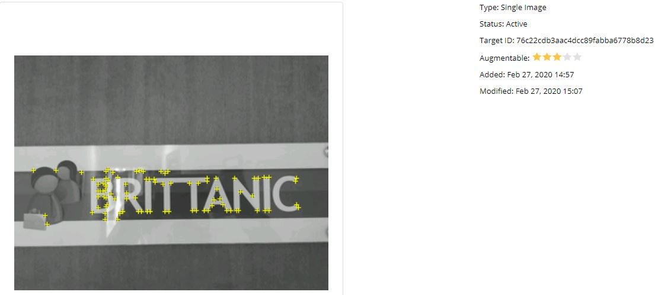
Data Handling
AR component
Images were taken
Initially of corridors
Feature extraction problem
Specific door signs were chosen as markers
Had unique distinct features
3D models were generated (11 in total)
Recommendation Component
A prototype dataset was built from scratch containing user-ratings
3 datasets in total for 3 separate tasks for the Visitors
Visit
Delivery
Interview

Slide 11
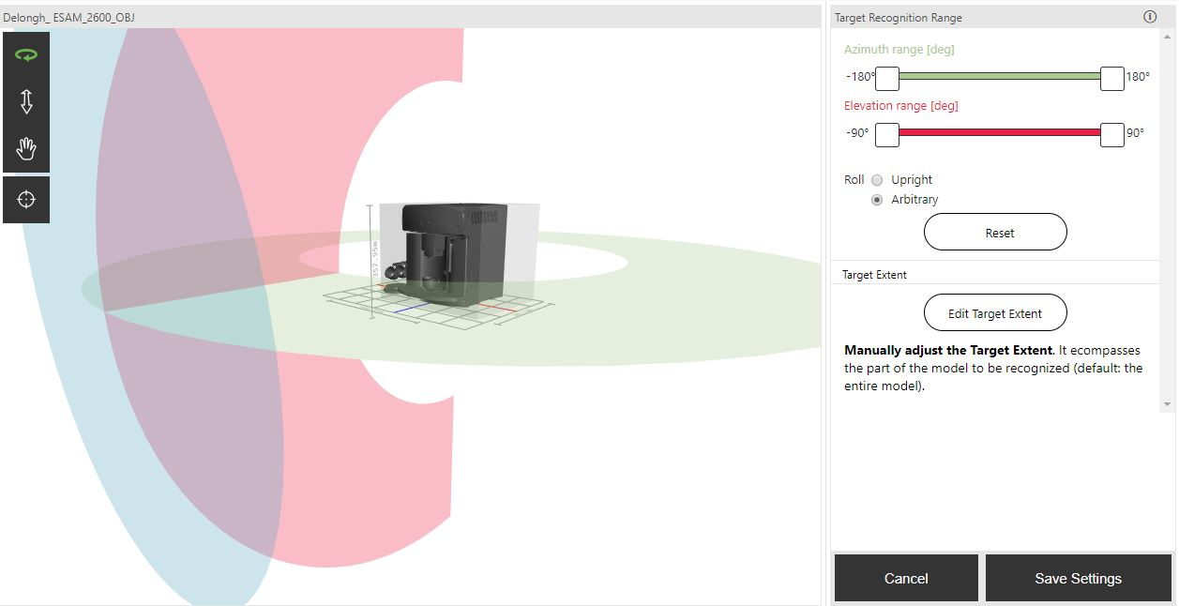
Feature Extraction
Images were fed into Vuforia’s library and were processed using traditional CV techniques.
Detecting edges and contours
3D objects were fed to Vuforia’s model generator to perform deep learning techniques on.
Detecting edges and contours at different lightings, distances, and angles.
Dataset built using different frames of the same object

Slide 12
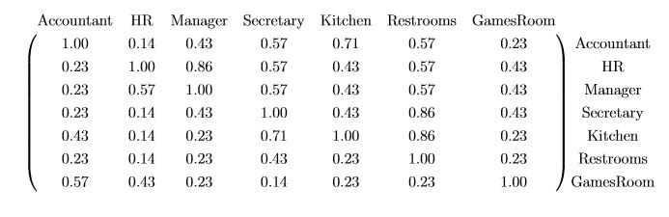
Feature Extraction (Cont)
User Recommendations
Collaborative Filtering
Features, were user ids, task ids and ratings.
Fed to SVD++ model
Matrix Factorisation method
Item-item similarity based matrix
Based on term frequency
Visibility based
Normalised
Based on the amount of times an office (term) is passed by the user while finding an office in particular (document)
Did not apply tf-idf
matrix scaling was done using one-fold normalisation since a term (a location within the office) appears in every task (a task is equivalent to a document)

Slide 13
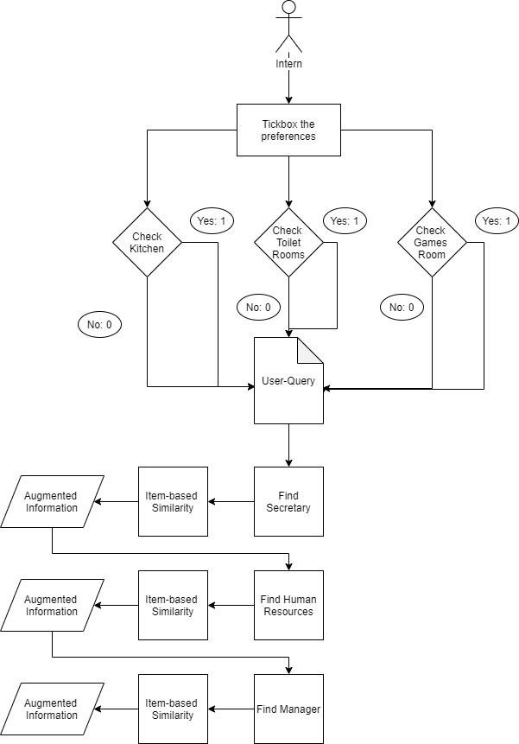
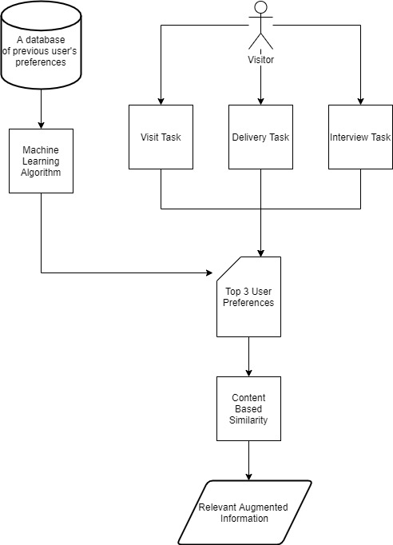
User-Query Models
Intern-Query Model
Visitor-Query Model

Slide 14
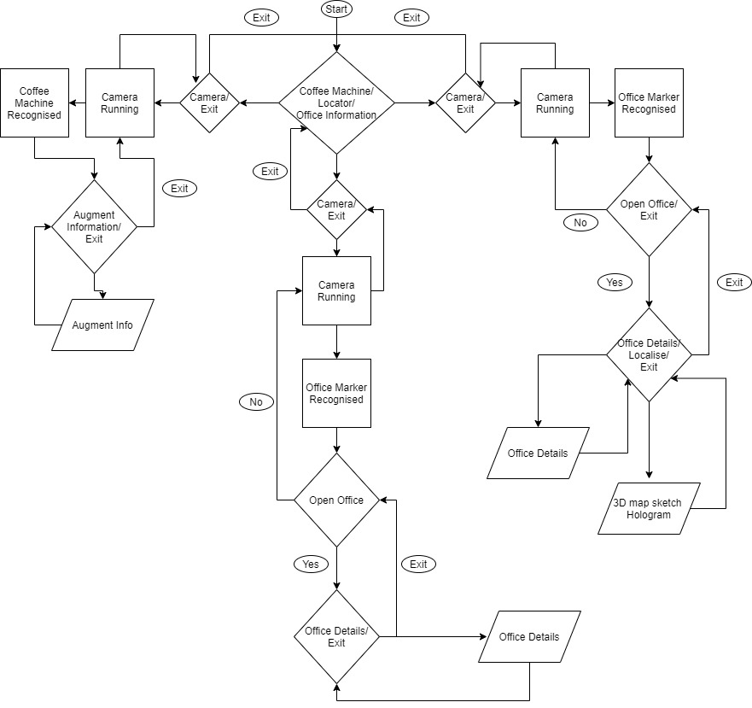
Architecture
Offices Information
(wandering around)
Locator
Intern
Step By step process
Secretary
HR
Manager
Visitor
Profiling on:
Visit
Interview
Delivery
Coffee Machine

Slide 15
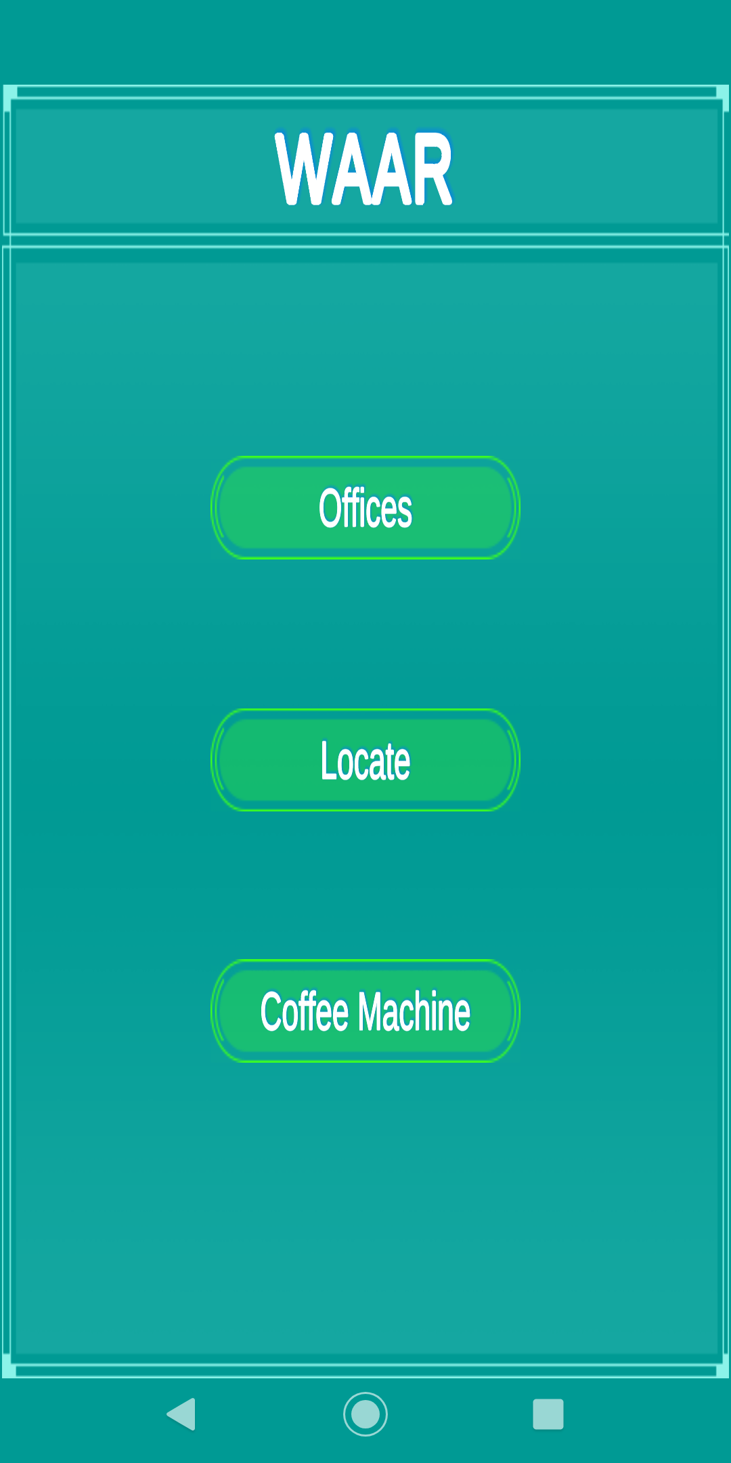
Main Menu

Slide 16
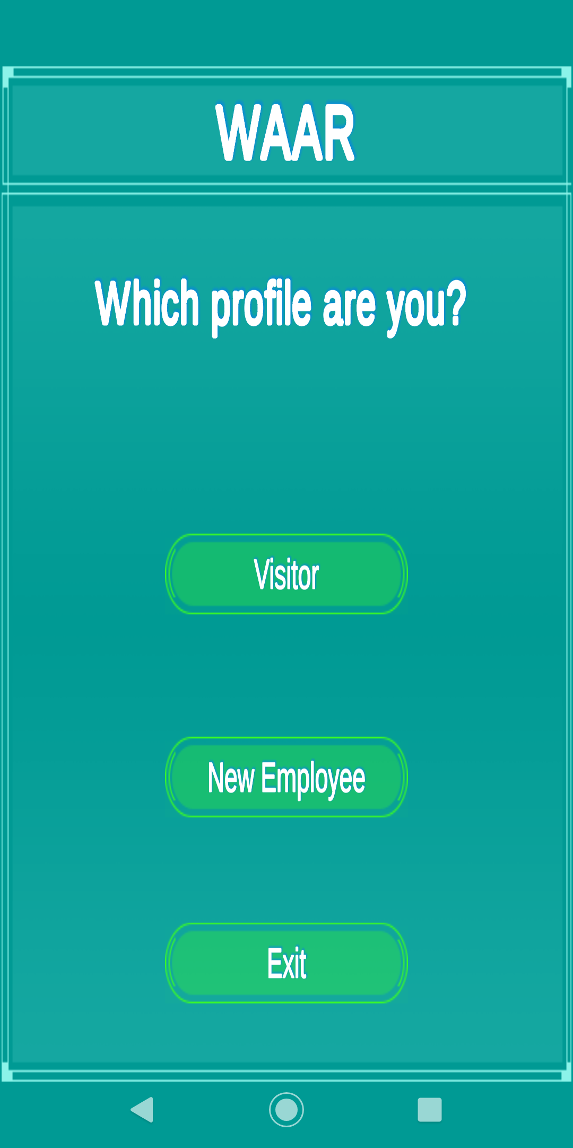
Choosing a user profile

Slide 17
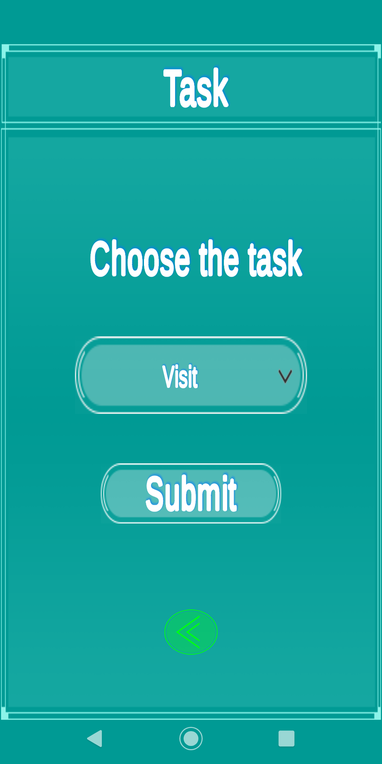
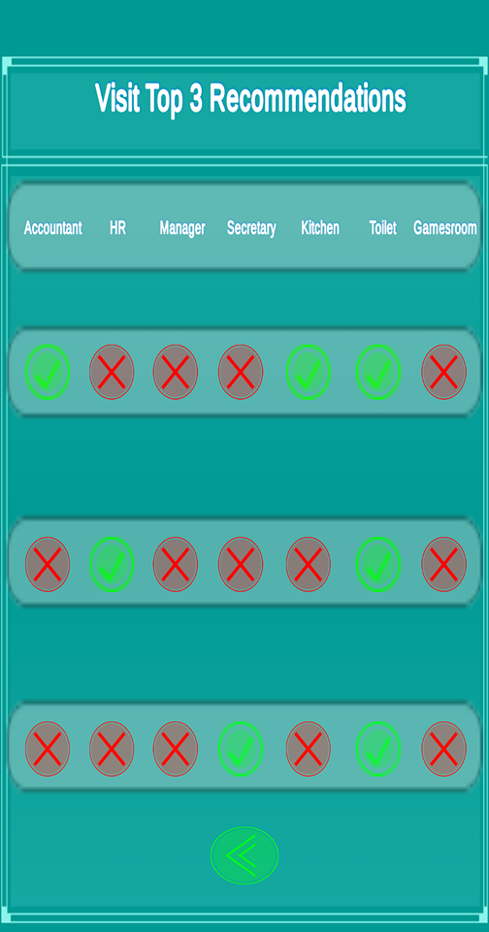
Visitor’s Section

Slide 18
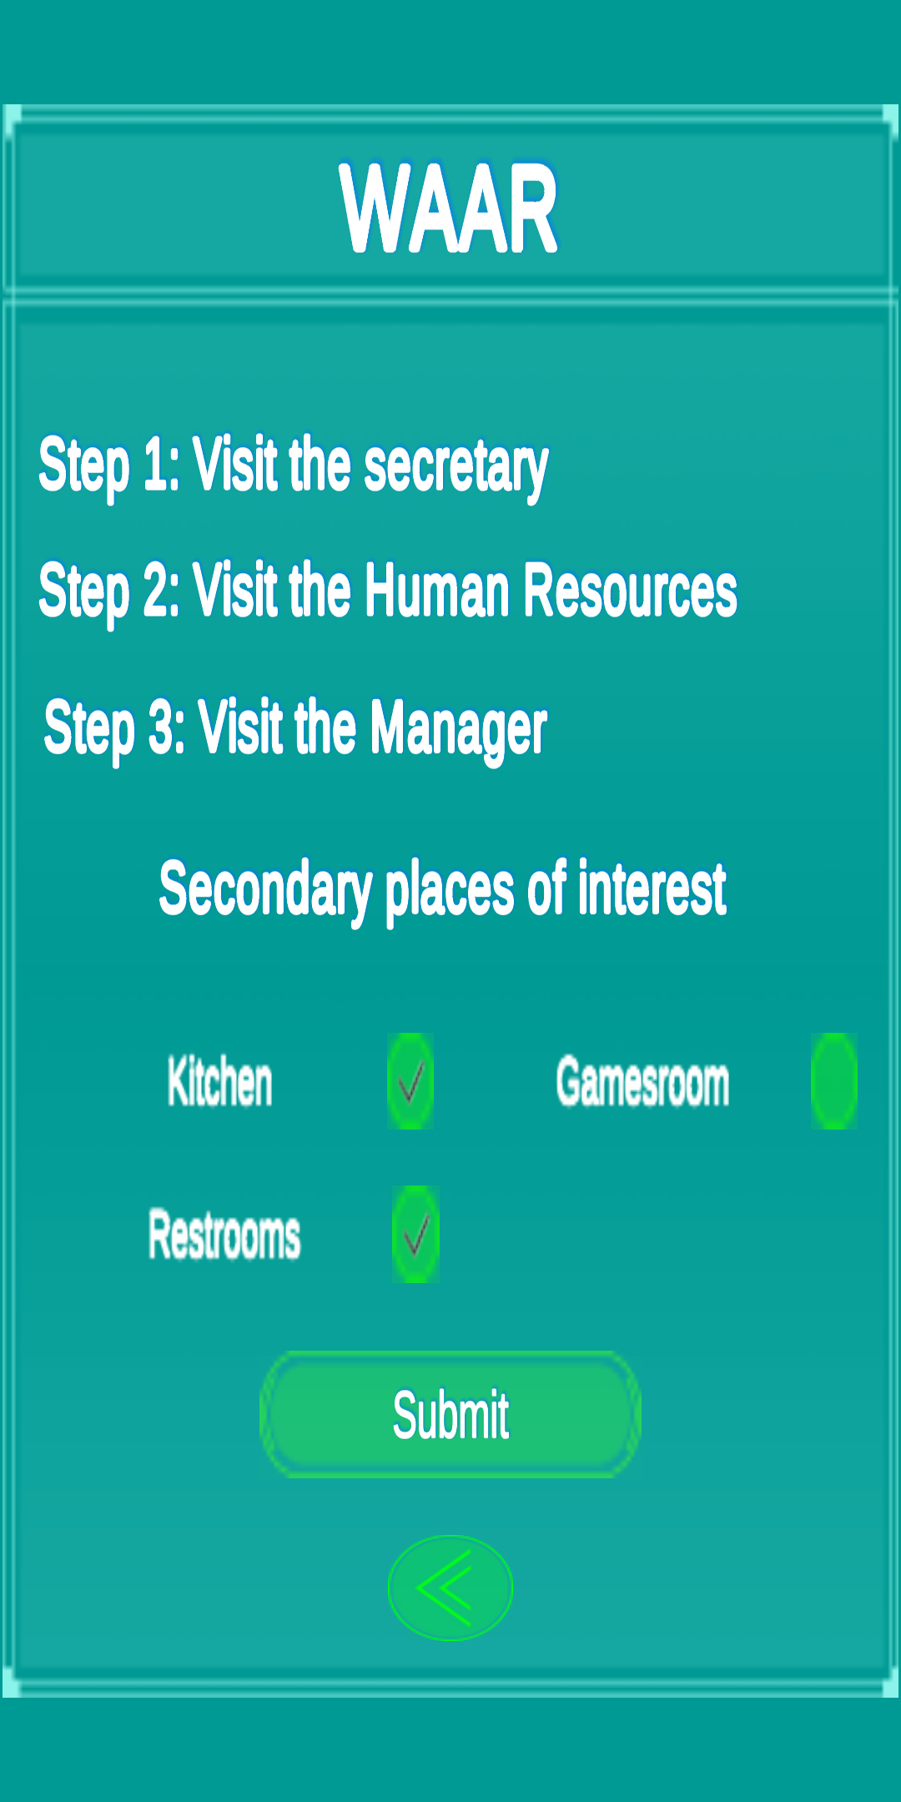
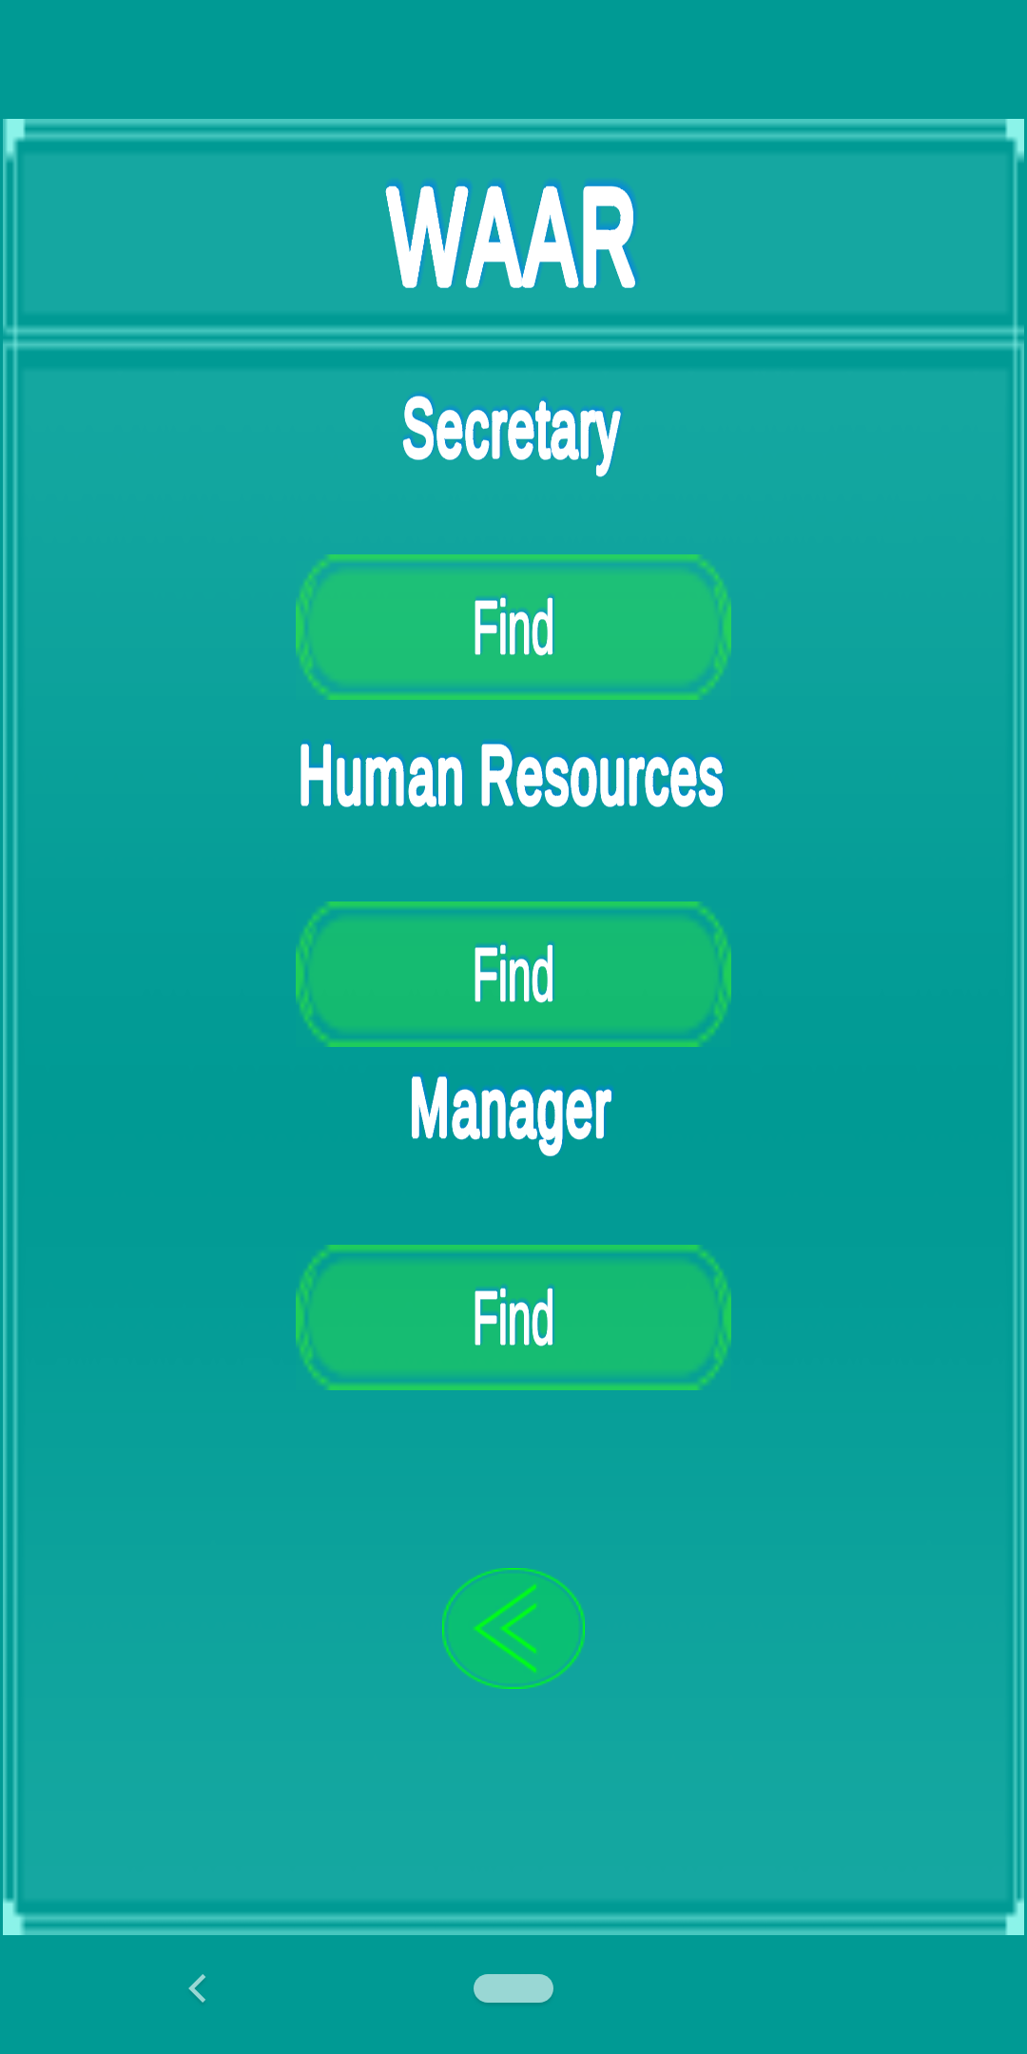
Intern’s Section

Slide 19
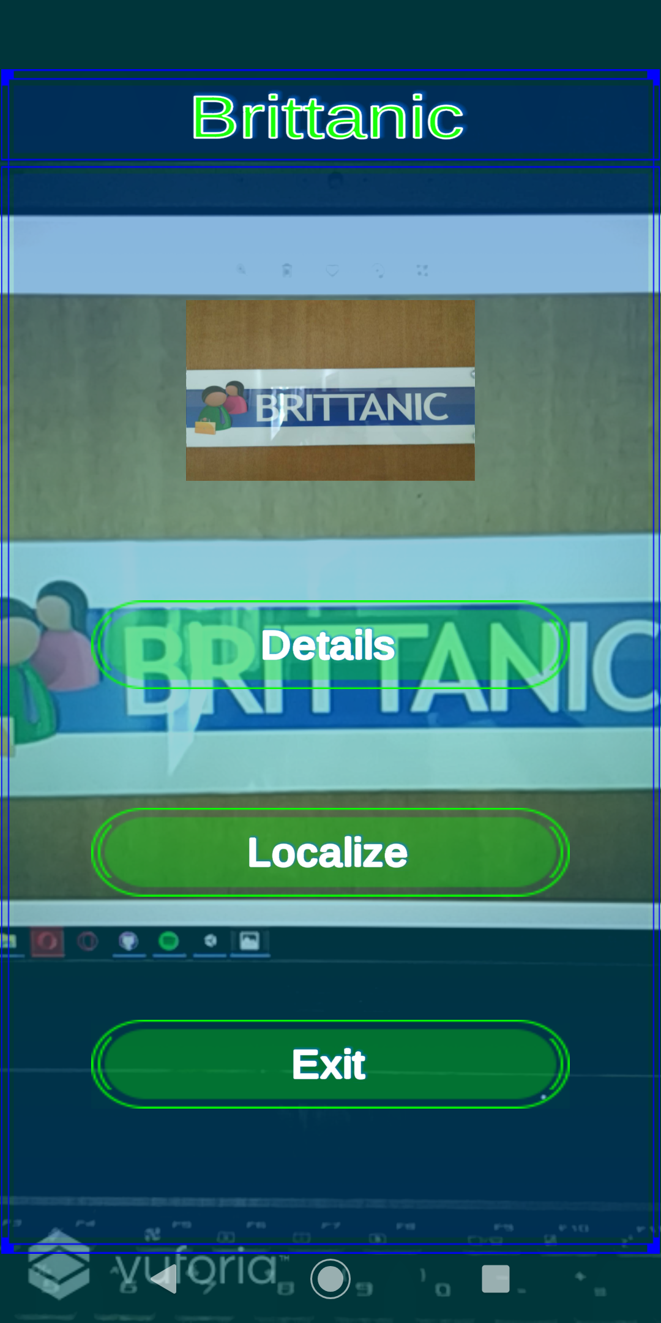
Augmented Reality Offices

Slide 20
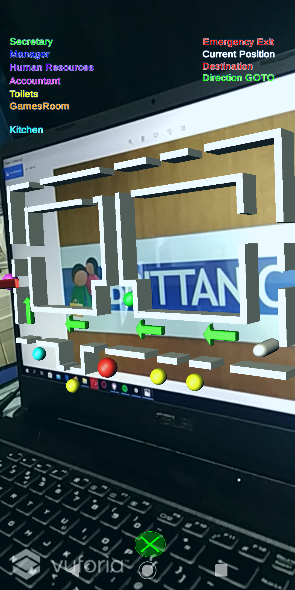
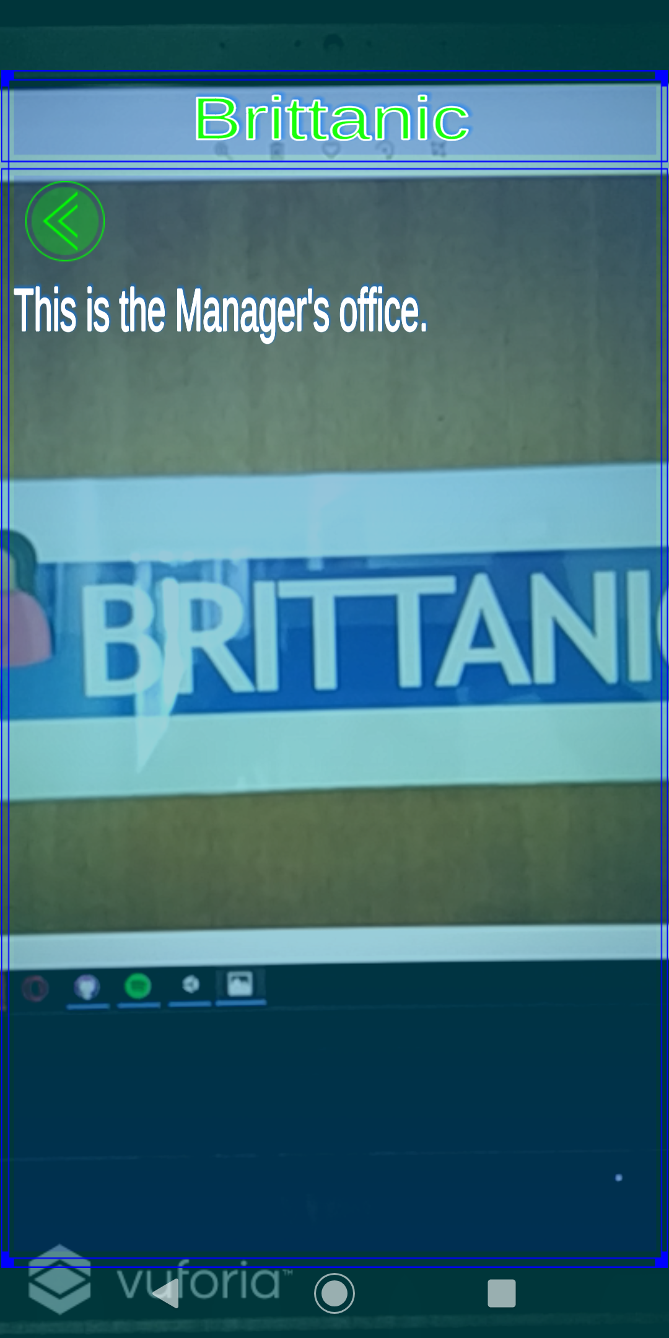
Augmented Reality Offices

Slide 21
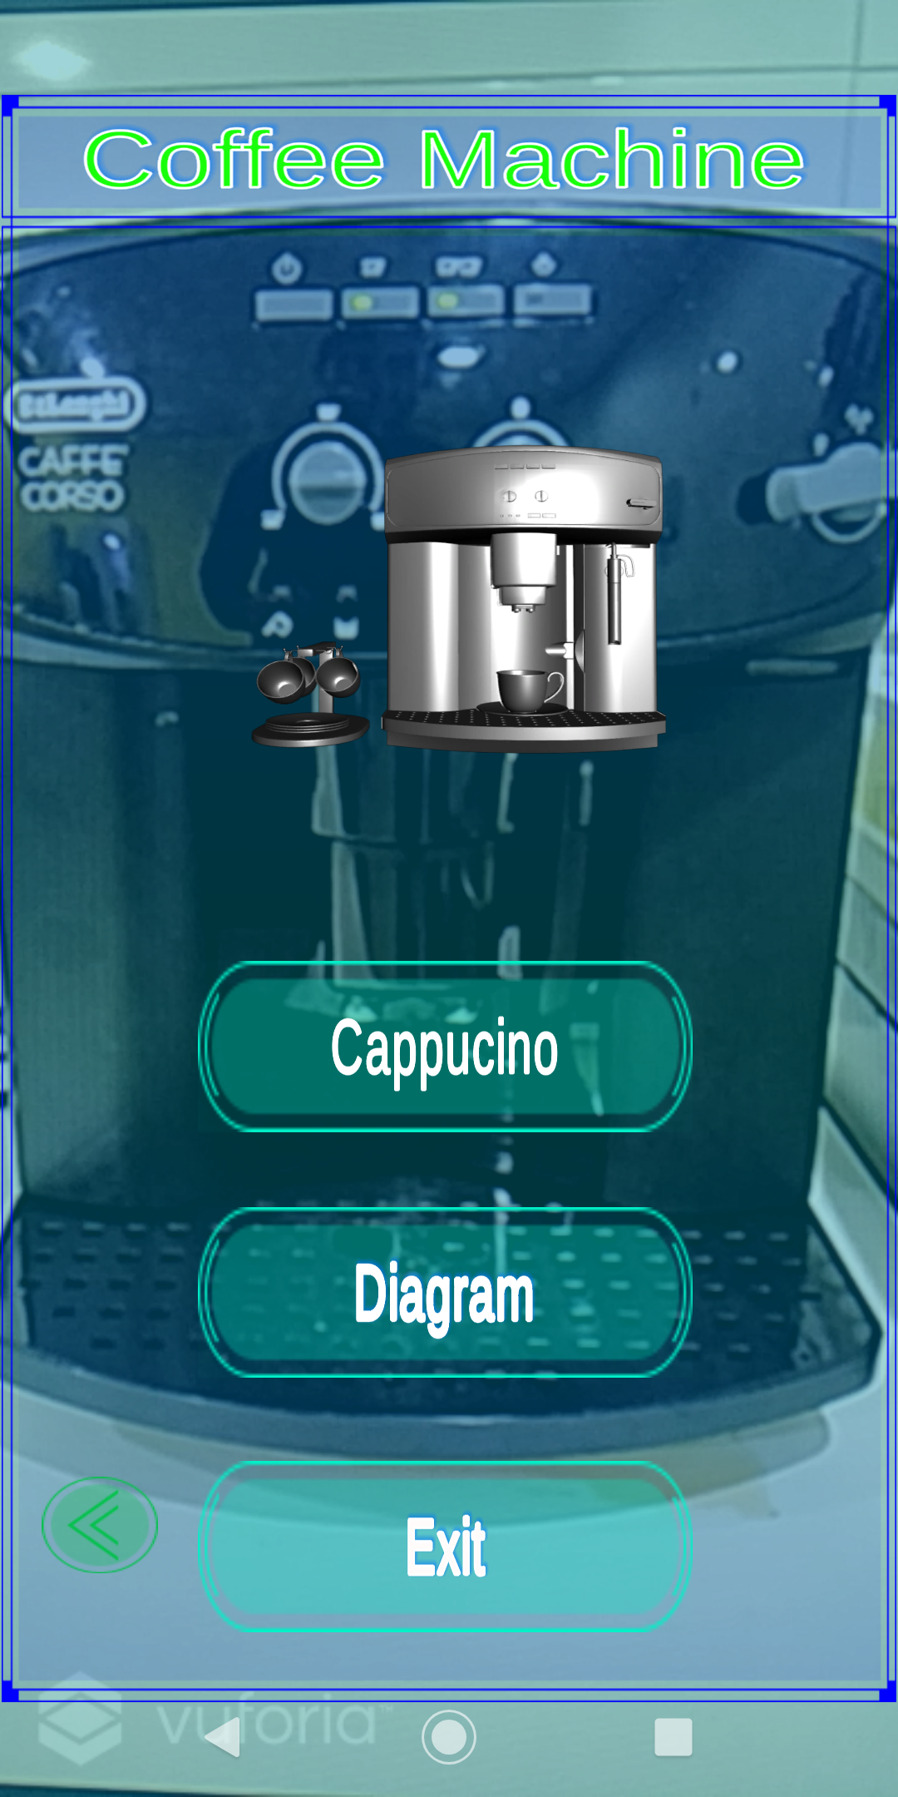
Coffee Machine

Slide 22
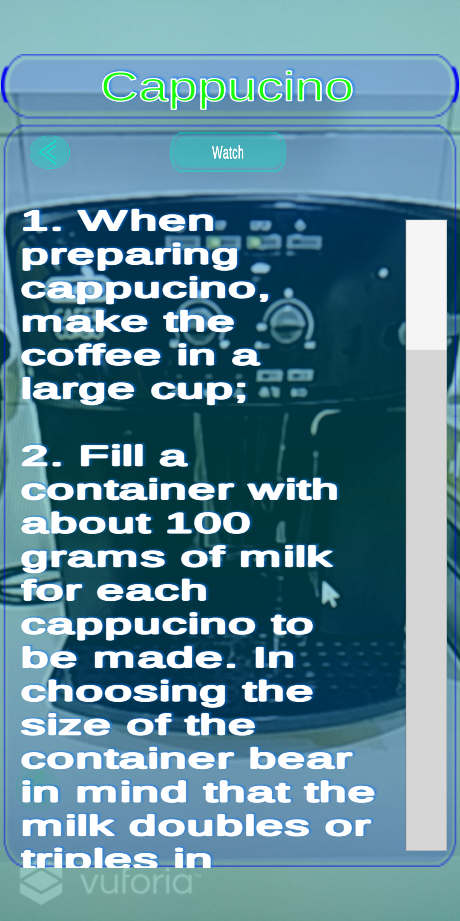
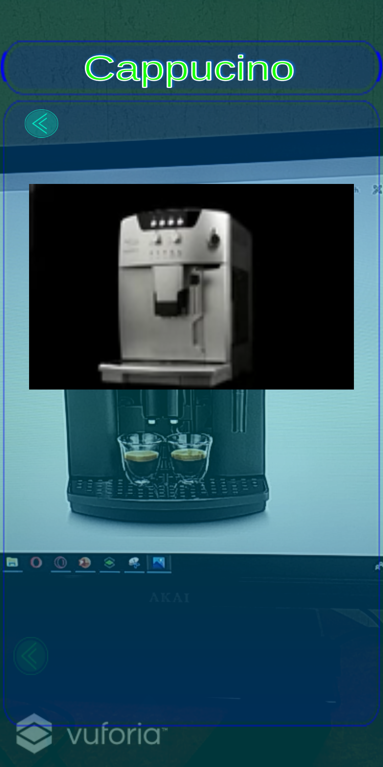
AR Coffee Machine Cappuccino Details

Slide 23
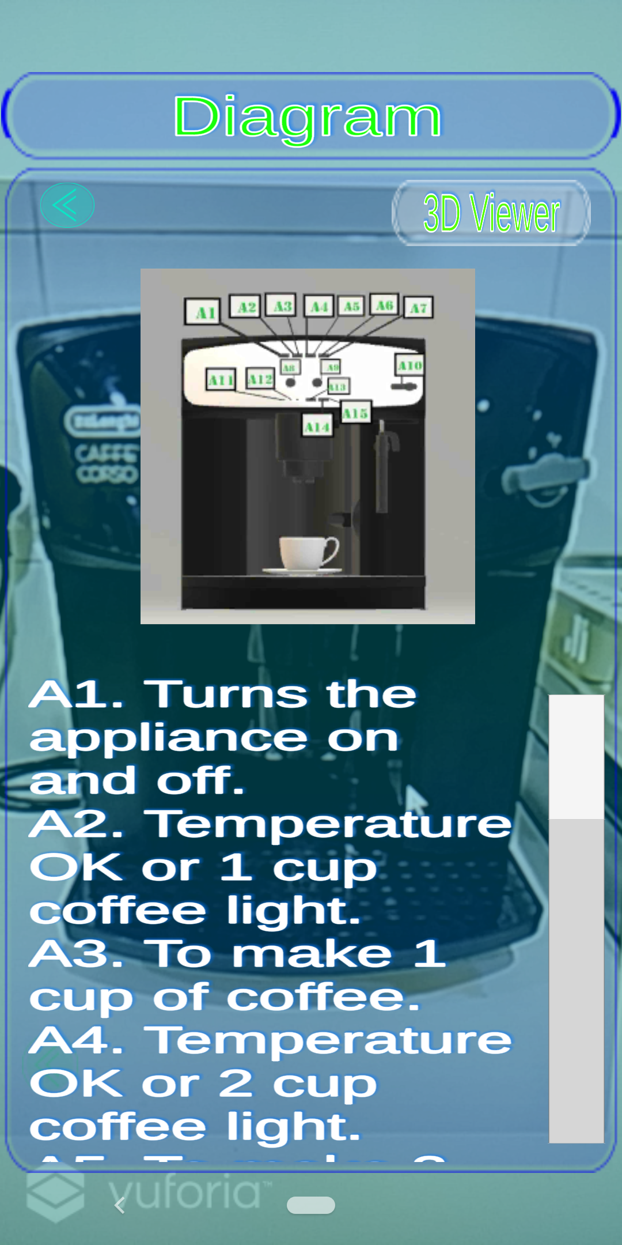
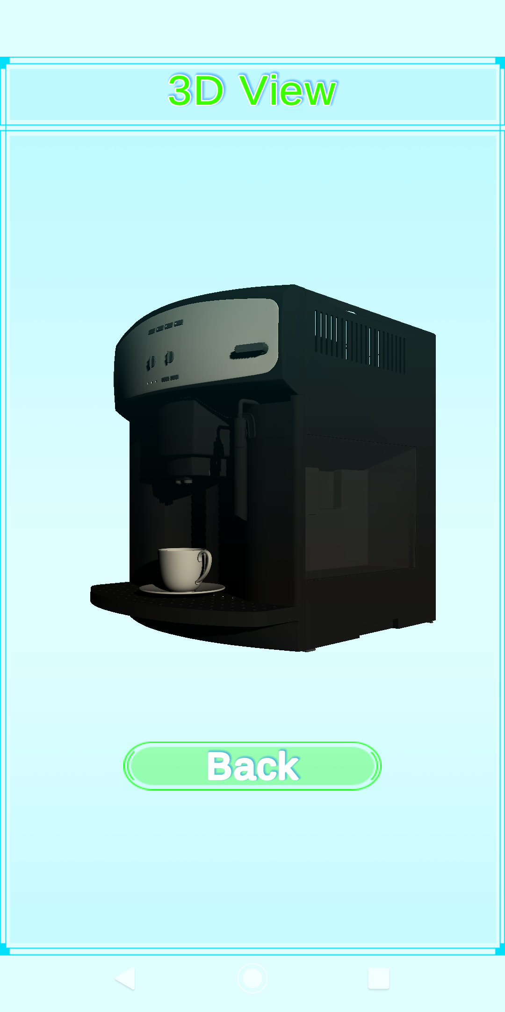
AR Coffee Machine Cappuccino Details

Slide 24
Testing And Evaluation

Slide 25
Quantitative AR Testing
Testing cannot be done on the algorithms’ performances of the library as developers do not have complete access to the API.
Common methods of the AR app’s tests are on the following component:
Colour Variance
Distance Variance
Orientation Variance
Occlusion Variance
Each test repeated a total of 21 times
10 – Image Targets
11 – Model Targets

Slide 26
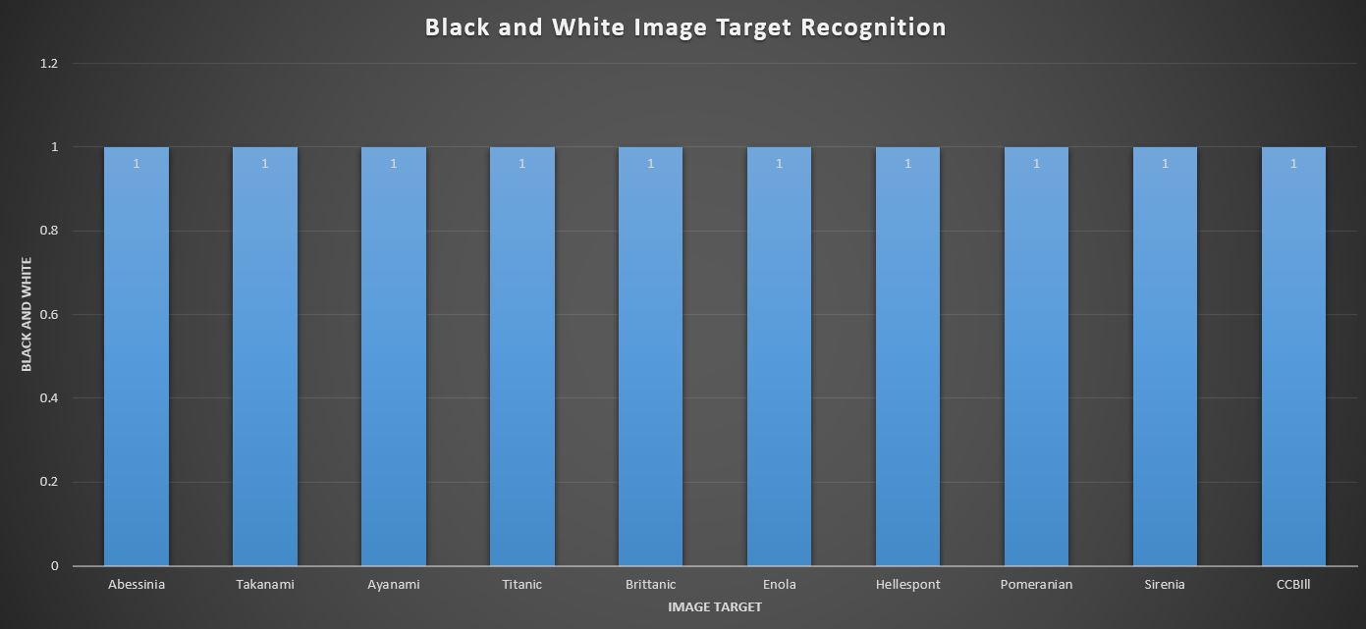
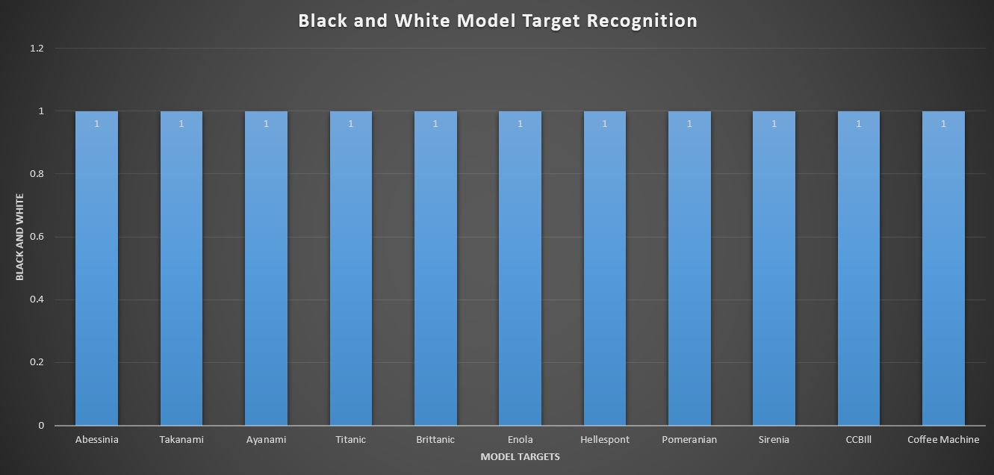
Colour Variance
Image Targets
Model Targets

Slide 27
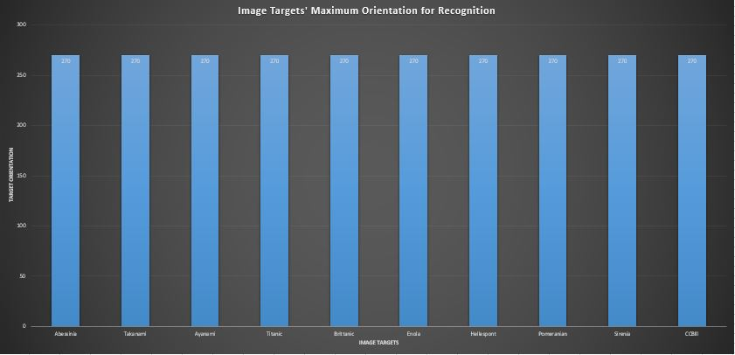
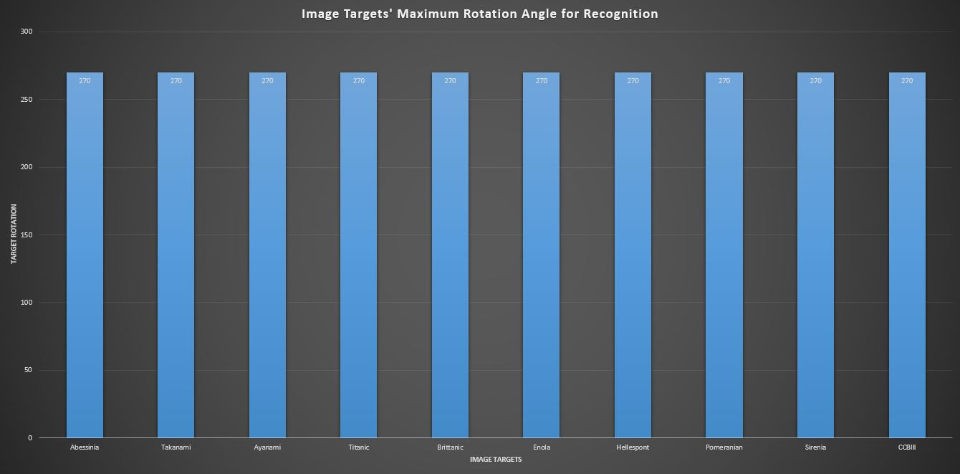
Orientation Variance
Image Targets
Model Targets

Slide 28
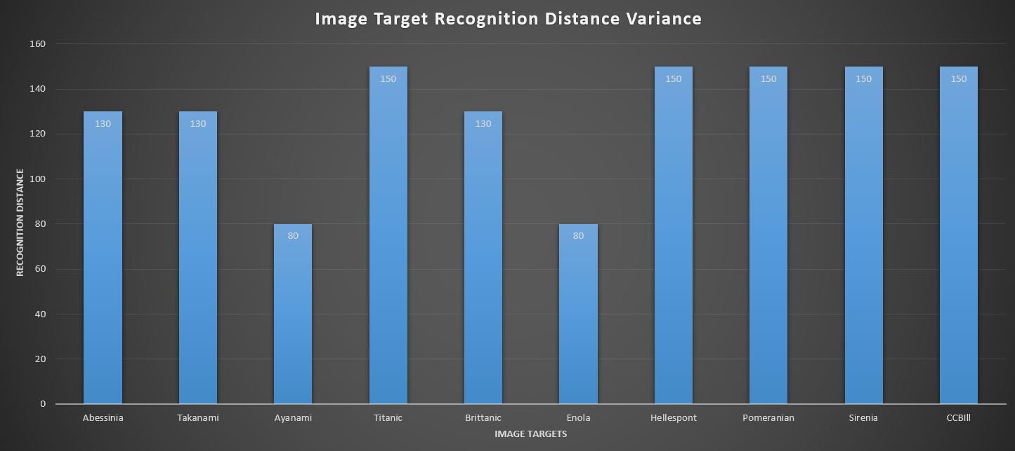
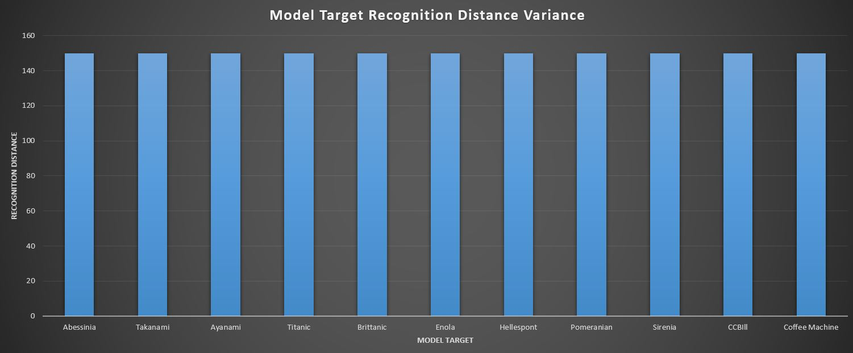
Distance Variance
Image Targets
Model Targets

Slide 29
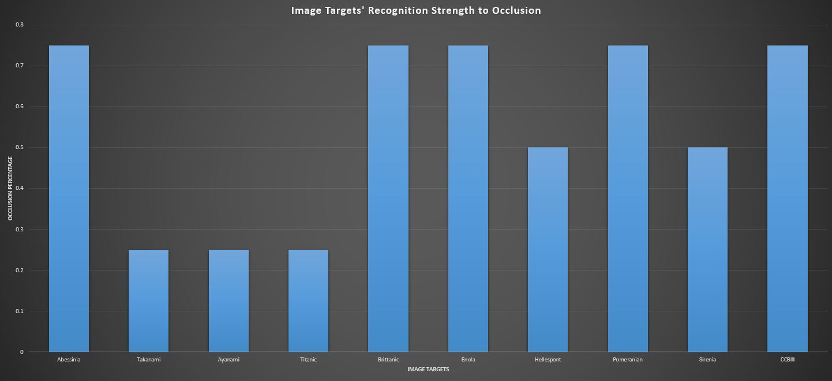
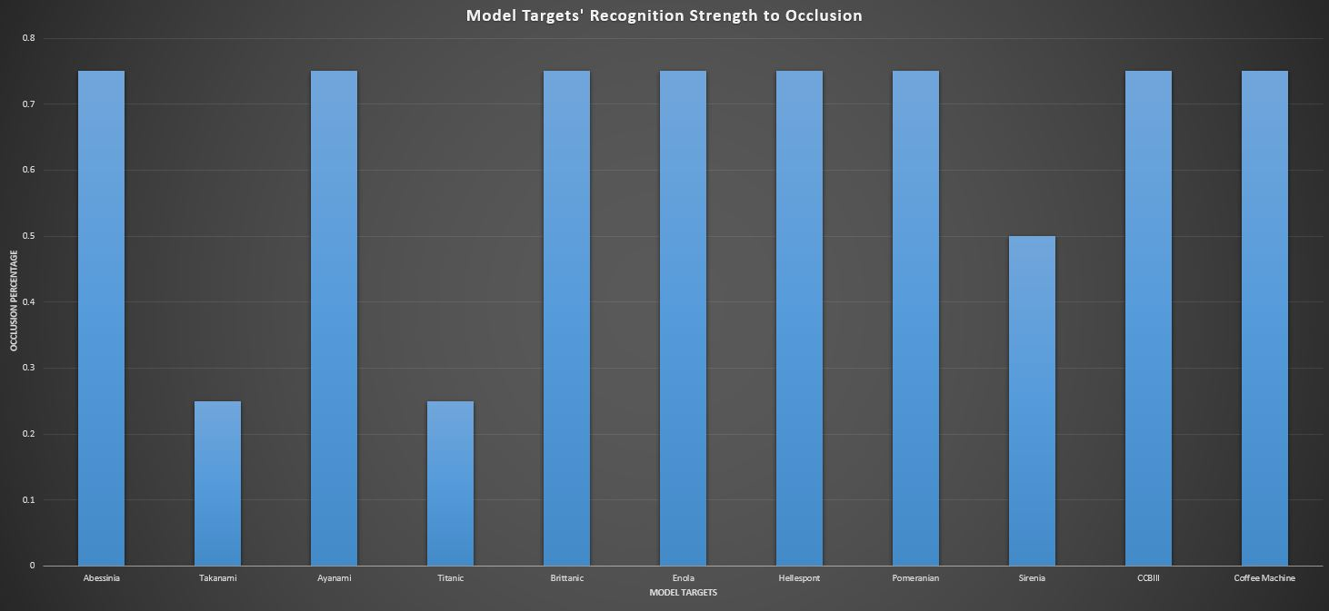
Occlusion Variance
Image Targets
Model Targets

Slide 30
Quantitative RS Testing
Baseline Comparison with
SlopeOne, BaselineOnly, Normal Predictor, KnnZscore, KnnBasic, KnnBaseline, SVD, CoClustering
Comparison on MAE and RMSE value
Recent Papers use MAE for comparison
Older papers use RMSE for comparison
Testing was done separately for each task (Visit, Interview, and Delivery)
Overall task Mean calculated
Secondary values calculated:
Test and Fit time
HyperParameter tuning was performed

Slide 31
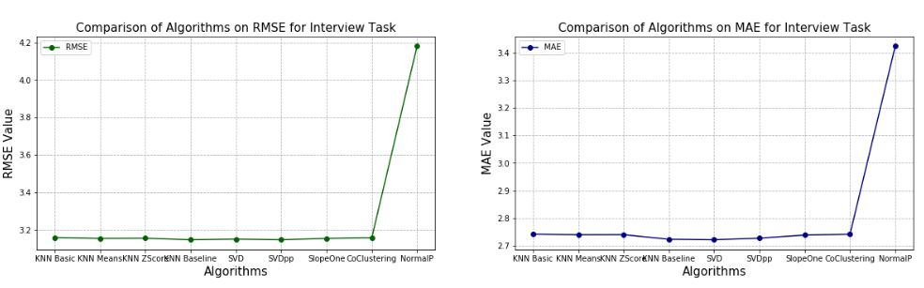
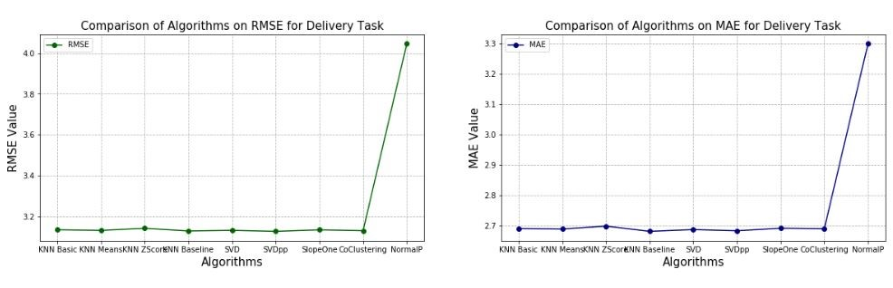
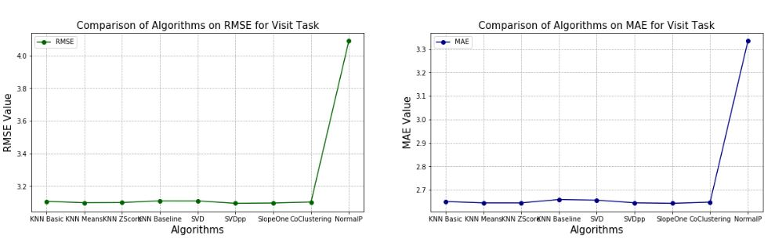
Baseline Comparison of Algorithms
Interview
Delivery
Visit

Slide 32
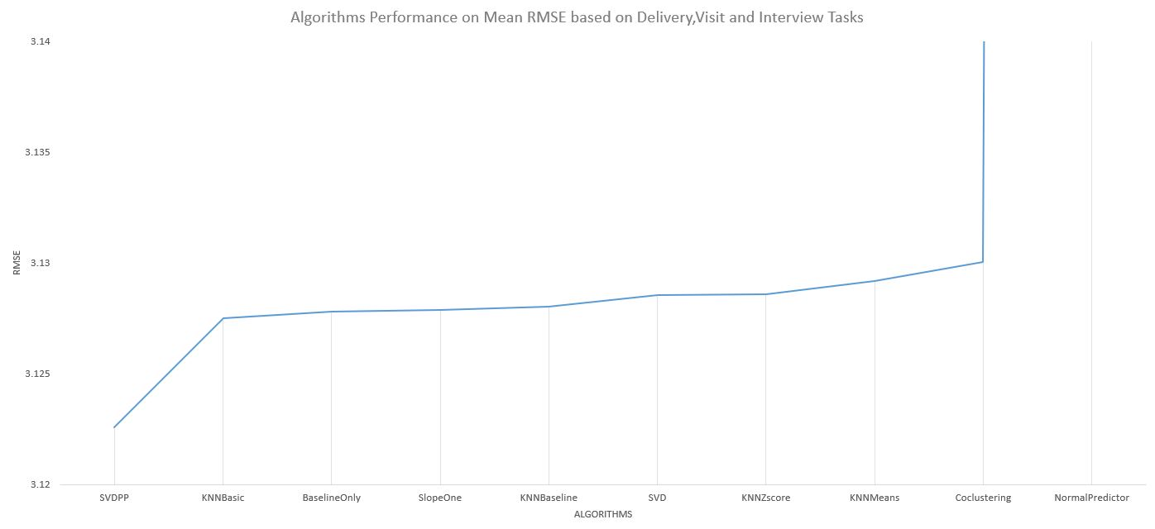
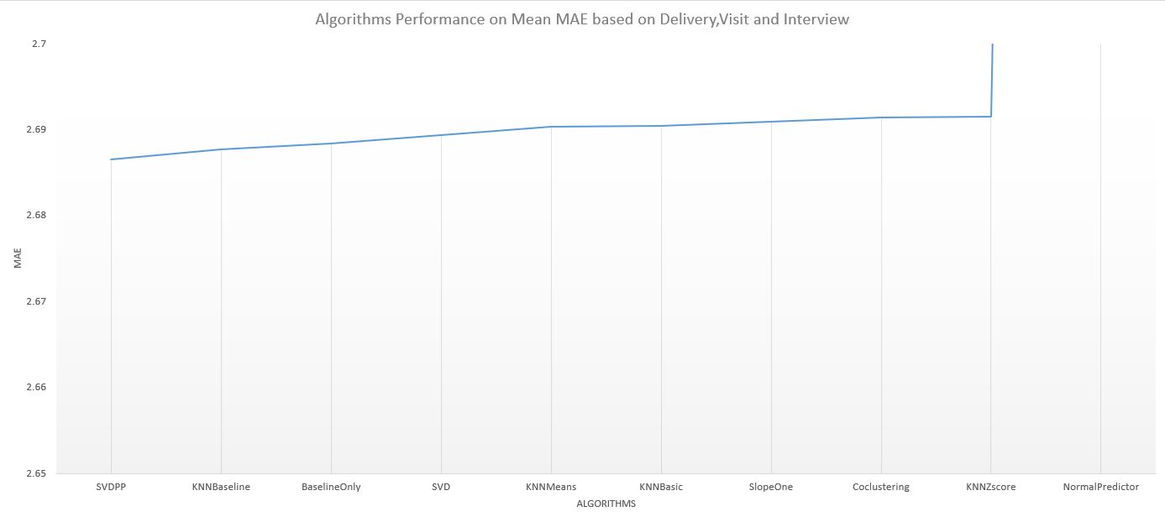
Baseline Comparison of Algorithms
Mean RMSE
Mean MAE

Slide 33
Quantitative Testing
In total 30 participants participated
15 CCBill employees
15 Non-CCBill employees
All of the participants found the application assisting for completing a given task such as locating an office
On average participants found augmented information as helpful (4.23)
On average participants found recommendation system as helpful (4.27)

Slide 34
Quantitative Testing (Cont.)
On average most participants agreed that the application was not affected by lighting and occlusion (1.63)
Interaction felt like natural and realistic (1.07)
Most users complained on the following issues
3D map was confusing
Unfortunately mostly to CCBill participants
Panning up and down
A greater amount found the application easy to use especially non-CCBill participants
CCBill participants found the recommendation system confusing as to how it functioned.

Slide 35
Future Work
Help the company gradually improve the recommendation algorithms they apply for profiling.
Random walk (if without a dataset), then apply an svd++, and finally make use of deep learning.
Switch from offline to online
Store models online which could be updated by user ratings on the flow and models are then trained as data increases. Thus, making the algorithms further adapted to the users.
Interactive AR
Interact with the company’s shared calendar to book meetings or offices for Standups
Interact with company’s devices such as punch-clocks or even the coffee machine
Improve marker trackability
Reduce the panning issue
Make use of a location-based AR
Company might need to invest further
Use detailed 3D models of the interior plots and apply deep learning.

Slide 36
Future Work (Cont.)
Location based AR would further help reduce the need of using a 3D AR map and could allow one to work with live directions.
Include a smart navigation system which give the shortest route.
Introduce explainable AI
Provide set of tools and frameworks to interpret the models used.
Improve aesthetically the user-interface
Customisable UI, or using an adaptive user-interface.

Slide 37
Acknowledgements
The faculty for allowing me to perform such research
Dr.Camilleri for her constant support and feedback.
CCBill for allowing me to carry out the research within their workplace.

